Slide 1
Lecture 3: Dynamic programming

Slide 2
Why dynamic?
“…I felt I had to do something to shield Wilson and the Air Force from the fact that I was really doing mathematics… What title, what name, could I choose? I thought <…> lets take a word that has an absolutely precise meaning, namely dynamic, in the classical physical sense. It also has a very interesting property as an adjective, and that is it's impossible to use the word dynamic in a pejorative sense…Thus, I thought dynamic programming was a good name. It was something not even a Congressman could object to. So I used it as an umbrella for my activities."
R. Bellman, Eye of the Hurricane: An Autobiography (1984)

Slide 3
Dynamic programming idea
a hard problem
trivial problems

Slide 4
Knapsack problem
6
1$
4
2$
8
10$
2
3$
2
10$
8
c = [10 1 3 2 10]
s = [ 6 2 4 2 8 ]

Slide 5
DP for knapsack

Slide 6
DP for knapsack
Key formula (Bellman equations):

Slide 7
Dynamic programming: computation
 | n=0 | 1 | 2 | 3 | 4 | 5
k=0 | 0
1 | 0
2 | 0
3 | 0
4 | 0
5 | 0
6 | 0
7 | 0
8 | 0
c = [10 1 3 2 10]
s = [ 6 2 4 2 8 ]

Slide 8
Dynamic programming: computation
 | n=0 | 1 | 2 | 3 | 4 | 5
k=0 | 0 | 0
1 | 0 | 0
2 | 0 | 0
3 | 0 | 0
4 | 0 | 0
5 | 0 | 0
6 | 0
7 | 0
8 | 0
c = [10 1 3 2 10]
s = [ 6 2 4 2 8 ]

Slide 9
Dynamic programming: computation
 | n=0 | 1 | 2 | 3 | 4 | 5
k=0 | 0 | 0
1 | 0 | 0
2 | 0 | 0
3 | 0 | 0
4 | 0 | 0
5 | 0 | 0
6 | 0 | 10
7 | 0 | 10
8 | 0 | 10
c = [10 1 3 2 10]
s = [ 6 2 4 2 8 ]

Slide 10
Dynamic programming: computation
 | n=0 | 1 | 2 | 3 | 4 | 5
k=0 | 0 | 0 | 0
1 | 0 | 0 | 0
2 | 0 | 0 | 1
3 | 0 | 0 | 1
4 | 0 | 0 | 1
5 | 0 | 0 | 1
6 | 0 | 10 | 10
7 | 0 | 10 | 10
8 | 0 | 10 | 11
c = [10 1 3 2 10]
s = [ 6 2 4 2 8 ]

Slide 11
Dynamic programming: computation
 | n=0 | 1 | 2 | 3 | 4 | 5
k=0 | 0 | 0 | 0 | 0
1 | 0 | 0 | 0 | 0
2 | 0 | 0 | 1 | 1
3 | 0 | 0 | 1 | 1
4 | 0 | 0 | 1
5 | 0 | 0 | 1
6 | 0 | 10 | 10
7 | 0 | 10 | 10
8 | 0 | 10 | 11
c = [10 1 3 2 10]
s = [ 6 2 4 2 8 ]

Slide 12
Dynamic programming: computation
 | n=0 | 1 | 2 | 3 | 4 | 5
0 | 0 | 0 | 0 | 0 | 0 | 0
1 | 0 | 0 | 0 | 0 | 0 | 0
2 | 0 | 0 | 1 | 1 | 2 | 2
3 | 0 | 0 | 1 | 1 | 2 | 2
4 | 0 | 0 | 1 | 3 | 3 | 3
5 | 0 | 0 | 1 | 3 | 3 | 3
6 | 0 | 10 | 10 | 10 | 10 | 10
7 | 0 | 10 | 10 | 10 | 10 | 10
8 | 0 | 10 | 11 | 11 | 12 | 12
c = [10 1 3 2 10]
s = [ 6 2 4 2 8 ]

Slide 13
Dynamic programming: backtracking
 | n=0 | 1 | 2 | 3 | 4 | 5
k=0 | 0 | 0 | 0 | 0 | 0 | 0
1 | 0 | 0 | 0 | 0 | 0 | 0
2 | 0 | 0 | 1 | 1 | 2 | 2
3 | 0 | 0 | 1 | 1 | 2 | 2
4 | 0 | 0 | 1 | 3 | 3 | 3
5 | 0 | 0 | 1 | 3 | 3 | 3
6 | 0 | 10 | 10 | 10 | 10 | 10
7 | 0 | 10 | 10 | 10 | 10 | 10
8 | 0 | 10 | 11 | 11 | 12 | 12
c = [10 1 3 2 10]
s = [ 6 2 4 2 8 ]

Slide 14
Knapsack problem
6
1$
4
2$
8
10$
2
3$
2
10$
8
c = [10 1 3 2 10]
s = [ 6 2 4 2 8 ]

Slide 15
Dynamic programming in MATLAB
costs=[10 1 3 2 10];
sizes=[6 2 4 2 8];
K = 8;
table = zeros(K+1,numel(costs)+1); % table(k+1,n+1) = O(k,n)
for i=2:numel(costs)+1
table(1:sizes(i-1),i) = table(1:sizes(i-1),i-1);
table(sizes(i-1)+1:end,i) = max(table(sizes(i-1)+1:end,i-1),...
table(1:end-sizes(i-1),i-1)+costs(i-1));
end

Slide 16
Two enabling properties for DP
Optimal solution for the bigger problem gives optimal solutions for subproblems. Optimal knapsack for (K,N) also gives us several optimal knapsacks with smaller capacities / item sets
Number of subproblems is not excessive. In our case, it was K*N (so that we could solve it)

Slide 17
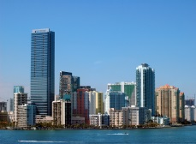
Hydrothermal scheduling

Slide 18
Hydrothermal scheduling
amount of “thermal” energy
cost of “thermal” energy
amount of water consumed
amount of “hydro” energy produced
the volume of water at the end of the period t
the inflow of water
power demand
the spillage of water
initial volume of water

Slide 19
Hydrothermal scheduling
Bellman equation:
Key idea: discretizing the volume variable

Slide 20
Visualizing dynamic programming
time
volume

Slide 21
General framework: optimizing actions
state after step i
action at step i
transition rule i
initial state
rewards

Slide 22
General framework: optimizing actions

Slide 23
General framework: optimizing actions

Slide 24
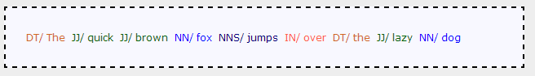
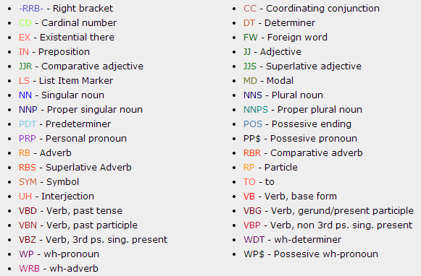
Part-of-speech tagging
http://cogcomp.cs.illinois.edu/demo/pos/

Slide 25
Part-of-Speech tagging
Dictionary information, capitalization, suffixes and prefixes, all of this for the preceding and subsequent words, etc.
Transition probabilities

Slide 26
Part-of-Speech tagging
Bellman equation:

Slide 27
Part-of-Speech tagging
Dictionary information, capitalization, suffixes and prefixes, all of this for the preceding and subsequent words, etc.
Transition probabilities
Bellman equation:

Slide 28
Sequence alignment
Linguistics/language analysis: Levenshtein edit distance
Bioinformatics: Needleman-Wunsch algorithm
Speech/signal processing: dynamic time warping
Massachusetts
GGTCACT
Madachussets
GCTACG

Slide 29
Sequence alignment
GGTCACTAACGCCTAAA
GGTACTAACTGCCTAGA
Distance = 2*Cost(indel) + 1*Cost(match)

Slide 30
Sequence alignment
G
GGTCACT
C
GCTACG
A
T
C
G
G
G
T
C
A
C
T

Slide 31
Sequence alignment: dynamic programming
Bellman equation:

Slide 32
Dynamic programming
A powerful method, when the task decomposes
Especially useful in problems associated with sequences
Can be applied to continuous variables via discretization
Does not care about the shape of the terms (convexity, etc.)
Forward pass gives the optimal value, backtracking gives the optimal variables

